Slide 1
Improved Cryptanalytic of Time-memory Trade-off Based on Rainbow Table
Tian, Yulong
2014.06

Slide 2
Outline
Introduction
Existing Problems
Best Parameters
Improved Table Structure
Experiment Results
Notes:
Some Background knowledge
We will take some parameters into account in this part
Give some tips for optimization

Slide 3
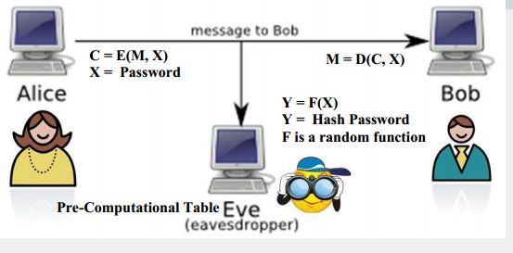

Introduce
Attack Model
$$C=E\left(M,X\right) for fixed M$$
Notes:
Eve(aiwu) get C and try to recover X with computational(kang pi te xin le)table.

Slide 4
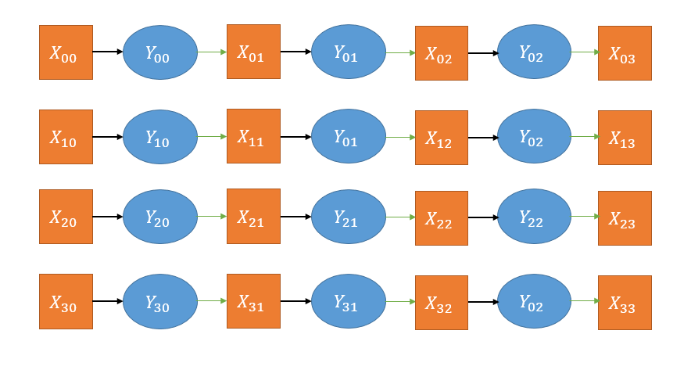
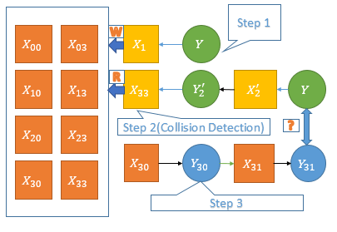
Introduction
Phase 1: Pre-computation
Phase 2: Online-Analysis
Notes:
I will introduce two kinds of algorithms. Classic and Rainbow Table. The difference among them is different reduction function.

Slide 5
Introduction
Starting Points(SPs) chosen randomly
End Points(EPs)
Reduction Function for new Key
Generate Chains
Discard all intermediate points
Sort on EP
Online-Analysis
1: Generating the pseudo-endpoints
2: Detecting collision
3: regenerating the rest part of the chain
Notes:
This slide give the detail of the technology. First part is the pre-computational. Second parts shows online-analysis. We should notice SP and EP, which would be used in rest of the report.

Slide 6
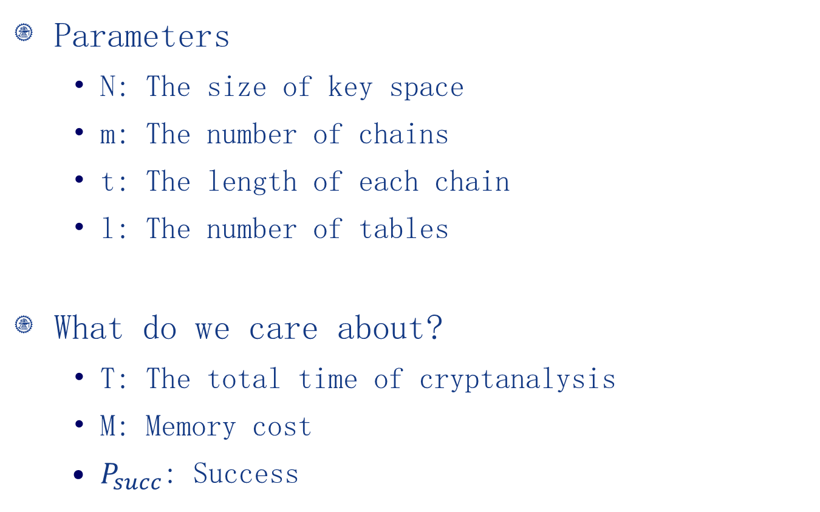
Existing Problems
Parameters
N: The size of key space
m: The number of chains
t: The length of each chain
l: The number of tables
What do we care about?
T: The total time of cryptanalysis
M: Memory cost
$P_{succ}$: Success

Slide 7
Existing Problems
Classification of Optimization
Time optimization
Rainbow Table, Checkpoint, Probability…
Memory optimization
Starting Points(Consecutive)
Ending Points(Index Table)
??? ???
Time & Memory at same time?

Slide 8
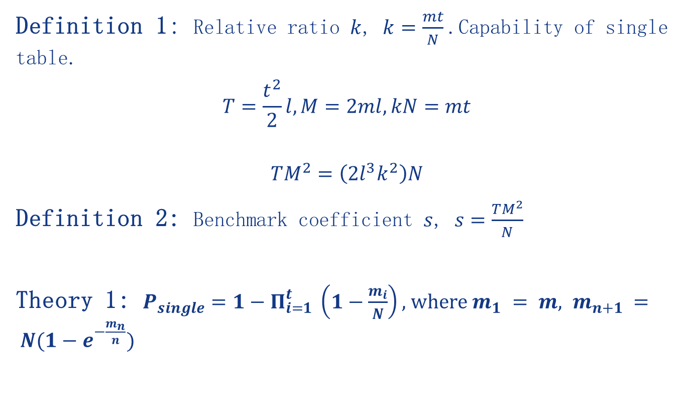
Benchmark Criteria
Definition 1: Relative ratio $k$, $k=\frac{mt}{N}$.Capability of single table.
$$T=\frac{t^{2}}{2}l, M=2ml, kN=mt$$
$$TM^{2}=\left(2l^{3}k^{2}\right)N$$
Definition 2: Benchmark coefficient $s$, $s=\frac{TM^{2}}{N}$
Theory 1: $P_{single}=1−Π_{i=1}^{t} \left(1−\frac{m_{i}}{N}\right),$where $m_{1} = m, m_{n+1} = N(1−e^{−\frac{m_{n}}{n}})$

Slide 9
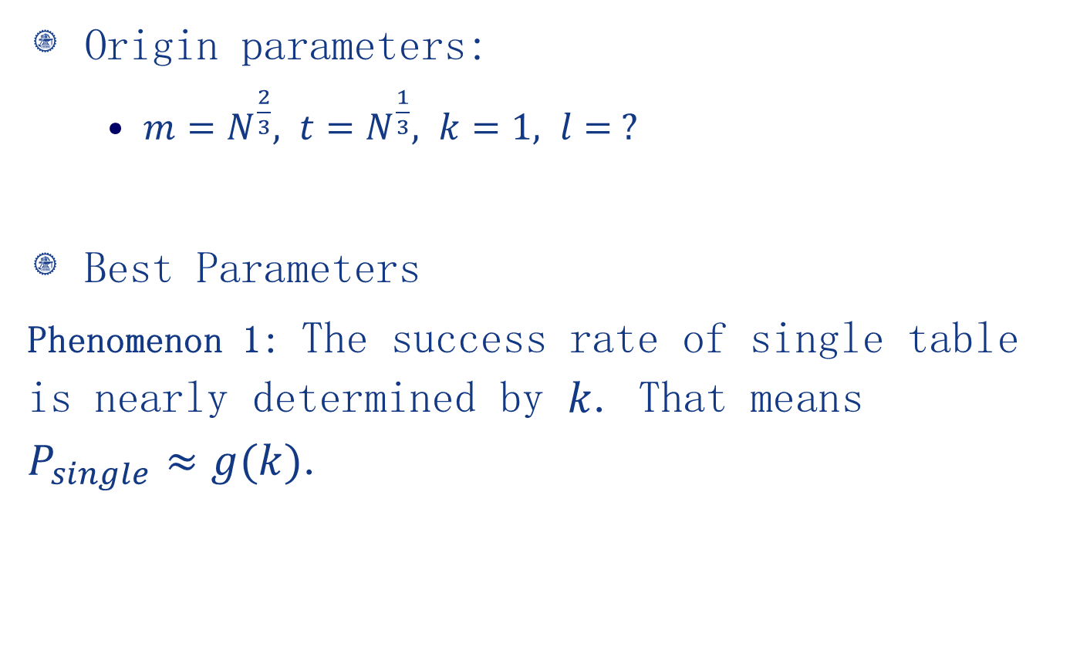
The First Optimization
Origin parameters:
$m=N^{\frac{2}{3}}, t=N^{\frac{1}{3}}, k=1, l= ?$
Best Parameters
Phenomenon 1: The success rate of single table is nearly determined by $k$. That means $P_{single}≈g(k)$.

Slide 10
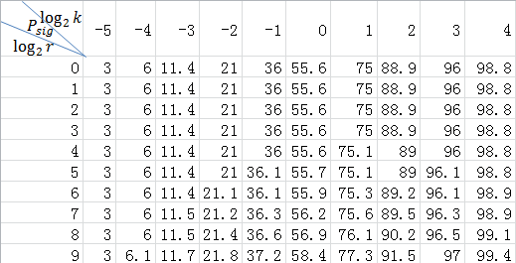
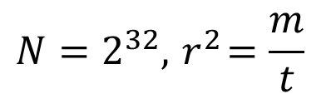
Best Parameters
$$N=2^{32}, { r}^{2}=\frac{m}{t}$$

Slide 11

Best Parameters
$P_{succ}={\left(1−P_{single}\right)}^{l}, P_{single}≈g\left(k\right)$
$l=\log_{g\left(k\right)}\left(1−P_{succ}\right)$
$s=2l^{3}k^{2}=2{{(log}_{g\left(k\right)}\left(1−P_{succ}\right))}^{3}k^{2}$
$s$ is determined by$k,P_{succ}$

Slide 12
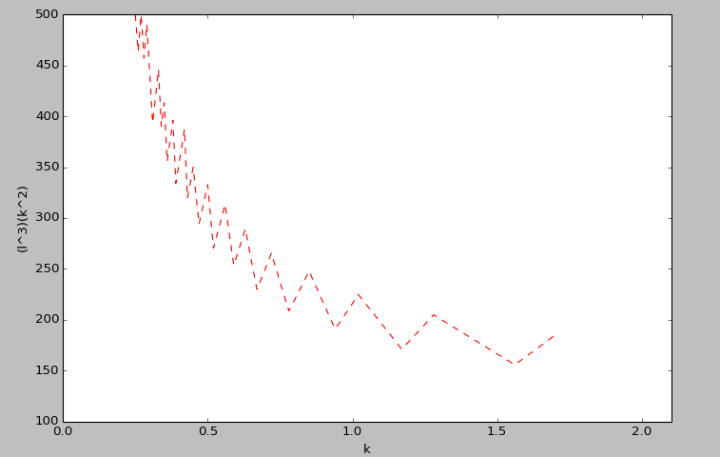
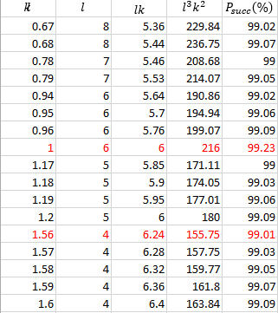
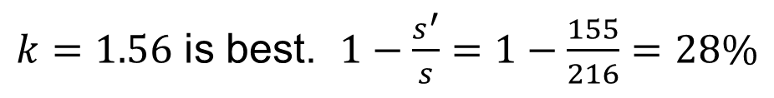


Best Parameters
Relatinship between $k \& s$
Relatinship between $k \& s$
$k=1.56$ is best. $1−\frac{s^{′}}{s}=1−\frac{155}{216}=28\%$

Slide 13
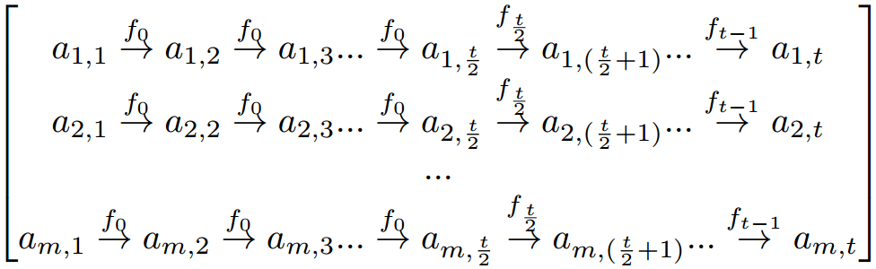
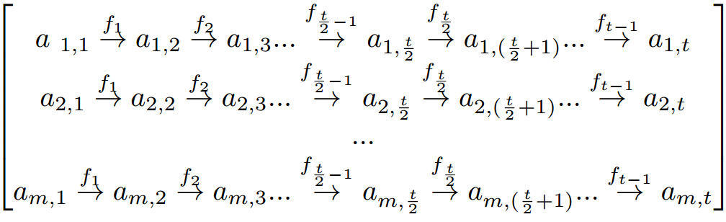
The Second Improvement

Slide 14

The Second Improvement
IDEA:
The cryptanalysis time of original rainbow scheme will be in exponent growth with $t$
$1+2+3+…+t≈\frac{t^{2}}{2}$
The cryptanalysis time of classic table will be in linearly growth with $t$
$1+1+1+…+1=t$
Notes:
If the collision is at the same point in the chain, it’s a merge.
Colliding chains will merge with the probability.

Slide 15
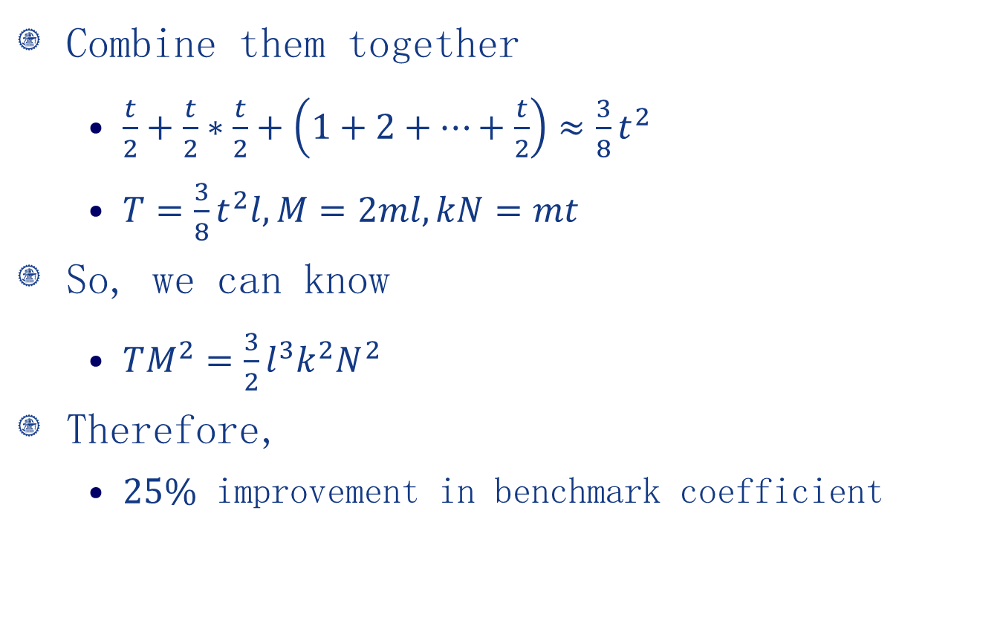
The Second Improvement
Combine them together
$\frac{t}{2}+\frac{t}{2}∗\frac{t}{2}+\left(1+2+…+\frac{t}{2}\right)≈\frac{3}{8}t^{2}$
$T=\frac{3}{8}t^{2}l, M=2ml, kN=mt$
So, we can know
$TM^{2}=\frac{3}{2}l^{3}k^{2}N^{2}$
Therefore,
$25\%$ improvement in benchmark coefficient

Slide 16
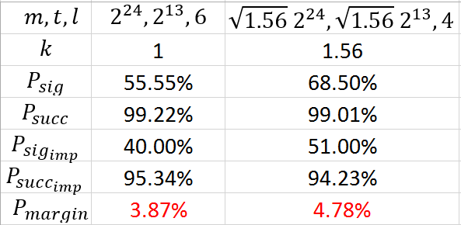
The Second Improvement
Success Rate

Slide 17
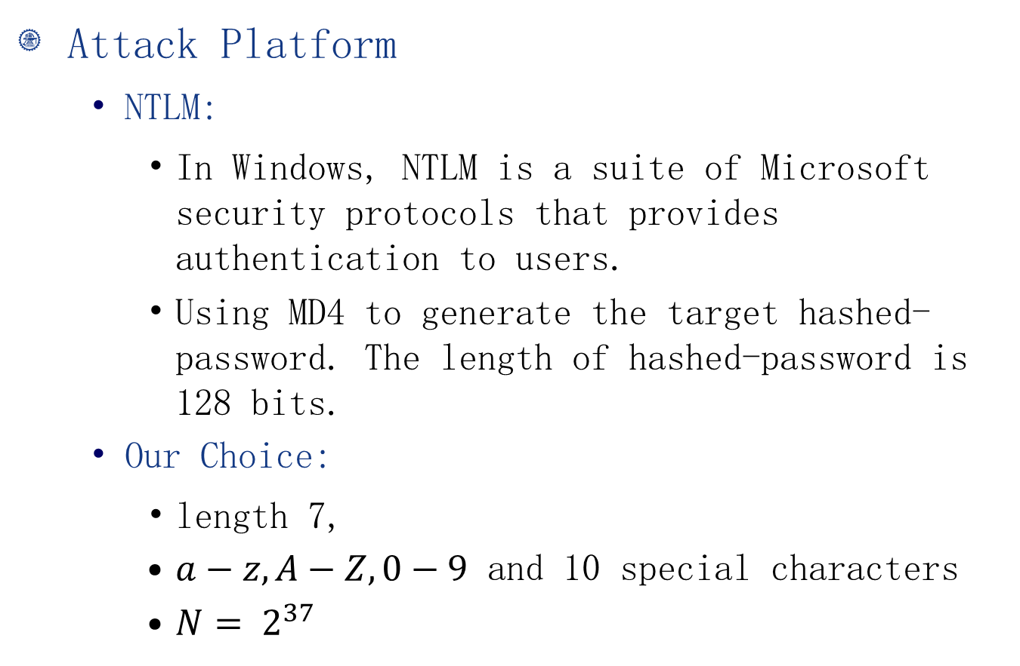
Experimental results
Attack Platform
NTLM:
In Windows, NTLM is a suite of Microsoft security protocols that provides authentication to users.
Using MD4 to generate the target hashed-password. The length of hashed-password is 128 bits.
Our Choice:
length 7,
$a−z, A−Z, 0−9$ and 10 special characters
$N= 2^{37}$

Slide 18
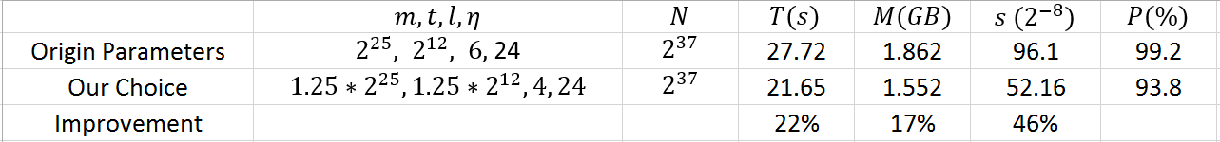
Experimental results
We have generated 1000 random password and try to crack them in my computer(Thinkpad T430U, Intel i5-3317 and 4G RAM).
We Combine Two method Together

Slide 19
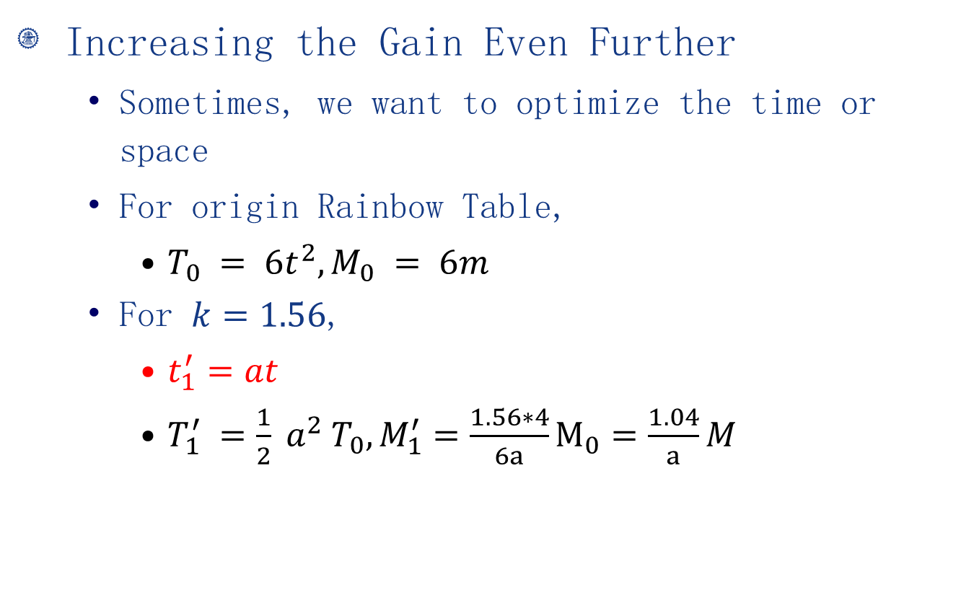
Experimental results
Increasing the Gain Even Further
Sometimes, we want to optimize the time or space
For origin Rainbow Table,
$T_{0} = 6t^{2}, M_{0} = 6m$
For $k=1.56$,
$t_{1}^{′}=at$
$T_{1}^{′} =\frac{1}{2} a^{2} T_{0}, M_{1}^{′}=\frac{1.56∗4}{6a}M_{0}=\frac{1.04}{a}M$

Slide 20
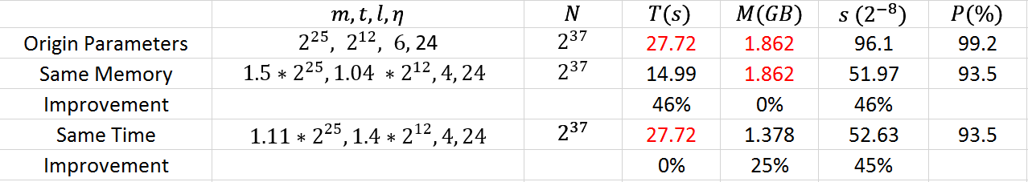


Experimental results
Increasing the Gain Even Further
Same Memory, $a=1.04$
Same Time, $a=\sqrt{2}≈1.4$
Improvement Upper Bound(COST 5.7% in success rate)
Time: $46\%$
Memory: $25\%$

Slide 21
Further Work
TBD

Slide 22
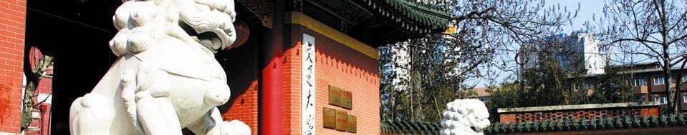
Thanks！

